Slide 1
Movies Recommendation System Project.
Improving Recommendation Accuracy through Model Optimization

Slide 2
Problem Statement
Users struggle to discover relevant movies efficiently.
Goal: Build a system that predicts user preferences accurately.

Slide 3
Objectives
Better decision making using data driven insights.
Build a movie recommendation system that suggests top 5 personalized movies to users.
Analyze user ratings to understand preferences and similarities.

Slide 4
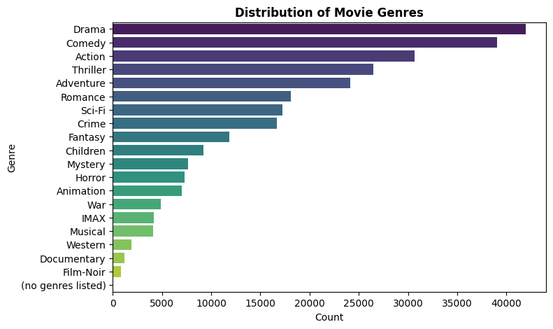
Distribution of movie genres
Popular genres (Drama, Comedy, Action) dominate the dataset
User interactions are concentrated in these categories
May lead to biased recommendations toward popular genres

Slide 5

Most rated movie genre
Similar to the overall genre distribution, a few genres dominate user engagement, reinforcing the need to account for popularity bias when generating recommendations.

Slide 6
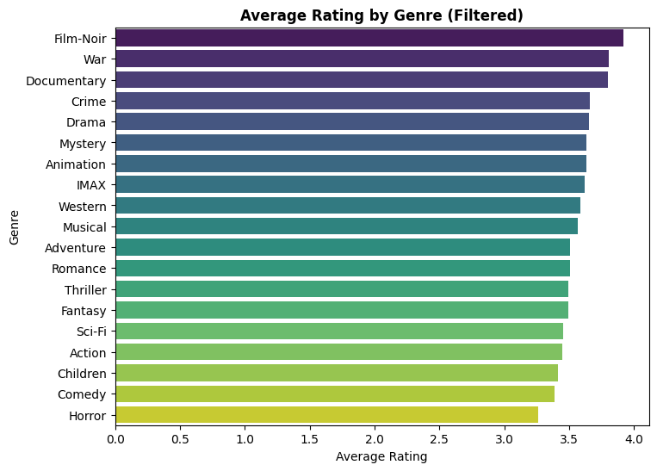
Average rating by genre
Highest-rated genres: Film-Noir, War, and Documentary
Moderately rated genres: Drama, Crime, Mystery, Animation
Lower-rated genres: Comedy, Children, and Horror

Slide 7
Approach
Used hybrid recommender function
Used collaborative filtering (SVD model)
Learned latent patterns between users and movies
Compared baseline vs optimized model

Slide 8
Key Results
Improved recommendation accuracy
Better alignment with user preferences
Demonstrated value of tuning process

Slide 9
Recommendations
Implement hybrid recommendation system.
Continuously collect user feedback.
Monitor model performance.
Address Data Sparsity-Integrate content based filtering techniques

Slide 10
Conclusions
Developed a movie recommendation system using collaborative filtering, model tuning and hybrid techniques.
Achieved strong RMSE performance and low MAE indicating reliable rating.
Generated personalized Top-5 recommendations.
Demonstrates real-world applicability and future potential.

